Slide 1
Common Problems and Solutions Bagfilter problems
General Description of Plant Problem/Situation

Slide 2
Equipment & Operational Data
General Plant Information
Kiln system: 4 SP
Clinker production: 2070 t/d
Heat consumption: 3400 kJ/kg
Plant elevation 450 m (i.e. ambient pressure = 960 mbar)
Gas volumes in front of filter:
Compound operation (60%): 225‘000 Nm3/h wet @ 10%O2*
18% moisture, T=95°C,
p_{stat}= -5 mbar
Direct operation (40%): 185‘000 Nm3/h wet @ 7%O2*
22% moisture, T=145°C,
p_{stat} = -10 mbar
* O2 value refers to the measured value at that filter inlet
2

Slide 3
Equipment & Operational Data
General Plant Information
Bagfilter system:
High pressure pulse jet system (6 bar)
6 compartments
1512 Nomex bags used (PA), length 4 m
Dimensions of filter:
Length: 11.64 m
Width: 8.6 m
Height: 10.0 m
Bag diam.: 160 mm
1.5 m
Out
8.5 m
In
3.88 m
3.88 m
3.88 m
3.04 m
2.52 m
3.04 m
3

Slide 4
Equipment & Operational Data
General Plant Information
Bags per row: 14
Distance bags to wall: 75mm
Distance between bags in a row: 50mm
Distance between two rows: 50mm
75 mm
18 rows
18 rows*
18 rows
75 mm
50 mm
18 rows
18 rows*
18 rows
50 mm
* In these compartments the cleaning system of 1 row is not working
4

Slide 5
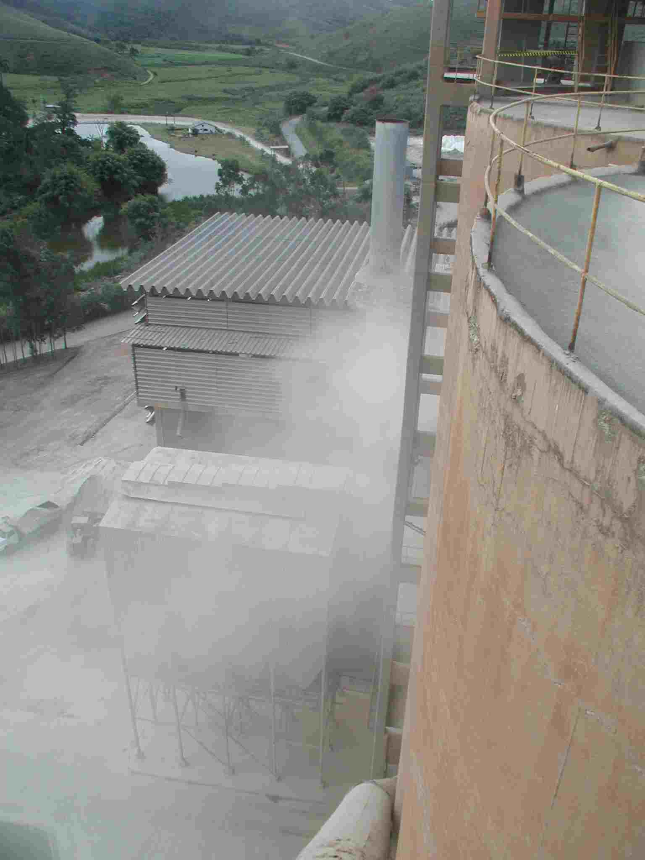
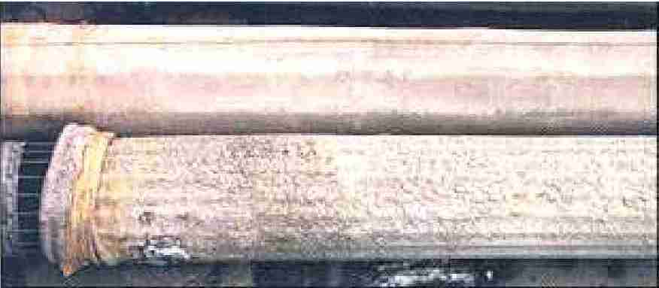
General Description of Plant Problem
Problem
High Δp over cloth (>20mbar) (despite cleaning)
Dust emissions > 50 mg/Nm3
Traces of corrosion are visible in the clean gas plenum
Short lifetime of bags (<12 months)
Filter under positive pressure as filter fan can not handle high Δp
Damaged bags
5

Slide 6
Problem Analysis and Discussion
Define Problem
Analyze Causes
Propose Measurements and Checks to perform
Identify most likely Causes
Identify Solutions
Propose Solutions (List)
6

